Slide 1
Presentation on Project Title: Arrow Master
Presented by:-
Name: Bondhon Das
ID: 20CSE016
Department of Computer Science
and Engineering
BSMRSTU
Supervised by:-
Nasif Ahmed
Assistant Professor
Department of Computer Science
and Engineering
BSMRSTU

Slide 2
Game Overview
Introduction
Implementation Details
Results and Screenshots
Limitation
Future Enhancements
Conclusion

Slide 3
Arrow Master Game - Introduction
Programming Language and Libraries
Graphics and Animation:
User Input Handling
Game Logic and Mechanics
File Handling

Slide 4
Key Features
Intuitive controls using keyboard input.
Engaging graphics and animations for an immersive gaming experience.
Challenging levels with moving objects to enhance the gameplay.
High score tracking to encourage competition and replayability.

Slide 5
Development Details
Programming Language: C++
Graphics Library: graphics.h
Development Environment: Codeblocks
File Handling: High score storage and retrieval using file handling techniques.

Slide 6
Results and Screenshots

Slide 7
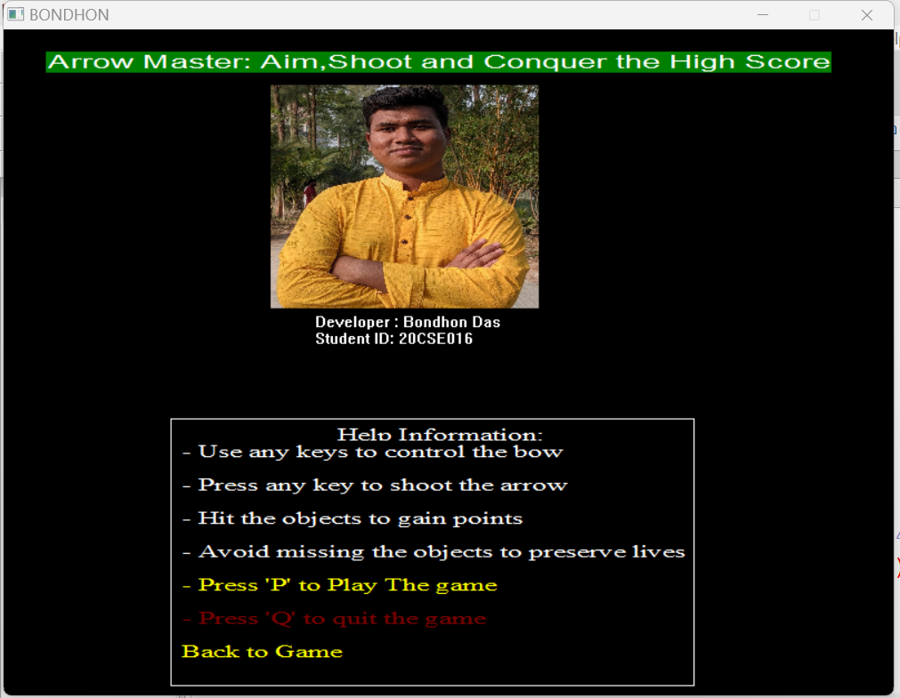
Home Page

Slide 8
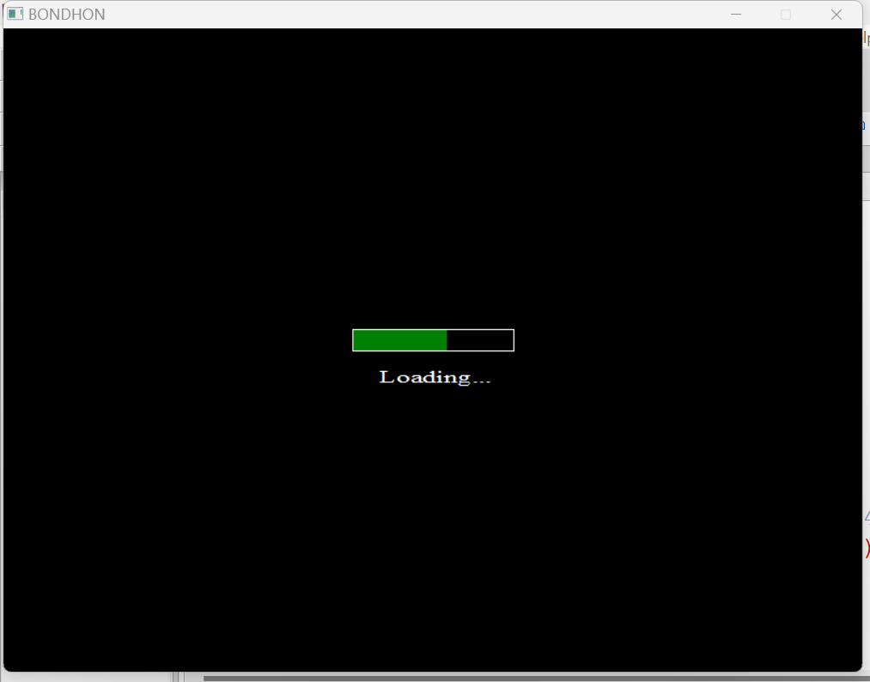
Loading

Slide 9
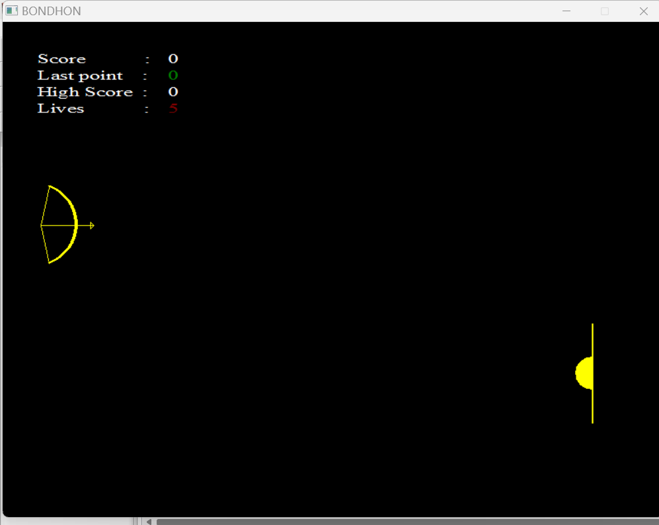
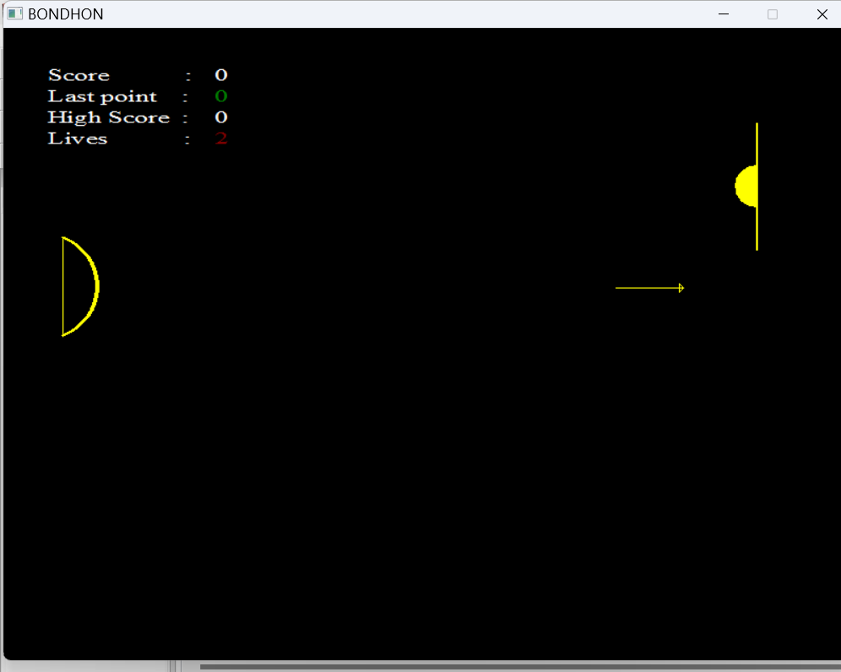
Arrow & Bow Animation

Slide 10
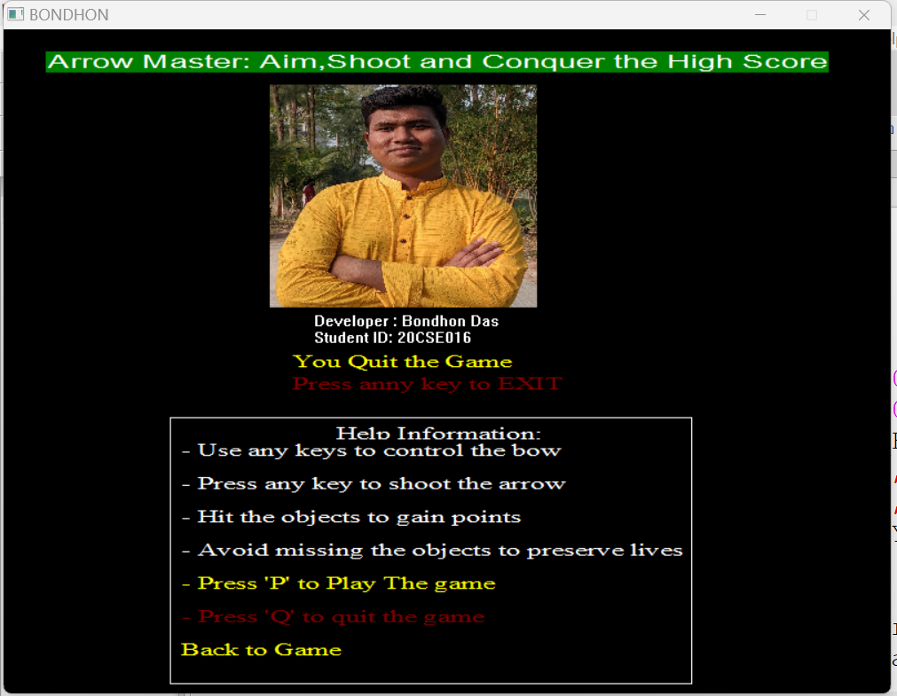
Game Exit Display

Slide 11
Limitation
Complexity
Graphics Limitations
Platform Dependency
User Interface
Sound Effects
Limited Gameplay Features
Development Constraints

Slide 12
Future Enhancements
Power-Ups and Special Arrows
Improved Graphics and Visual Effects
Enhanced Sound and Music
Customizable Bow and Arrow Designs
Add Registration Option
Solve all limitation problem

Slide 13
Q&A (Questions and Answers)

Slide 14
Conclusion
Positive reception, high scores highlight game's entertainment and potential.
Impressive showcase of graphics programming and game mechanics.

Slide 15
Thank You

